Slide 1
Persistent Array
Kanko Ghosh
B-CSE II

Slide 2
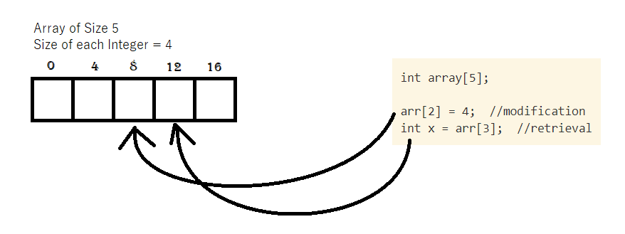
Ephimeral Array
Collection of items of same type stored in contiguous memory location
An element from a particular position can be retrieved or modified directly by calculating address of a location
Eg.
Required address of a position in an array = starting address+ (required index * size of data type)

Slide 3
Operations on array
storeArray(a, i, e): store the value present in e, in the i-th element of array a
retrieveArray(a, i) : return the value of the i-th element of array a

Slide 4
Persistent Data Structure
Persistency can be achieved in a data structure, when we can preserve the previous version of itself even after modifying the data structure
Persistency can be partial: older versions can be retrieved but cannot be modified; and fully persistent: older versions can be modified as well as read by the user
Array can also be made persistent by few techniques

Slide 5
Copy on write method
Method 1

Slide 6
Copy on Write method
On updating an array, a new array is created (allocating memory followed by copying the data) and the corresponding update is made in the new array
Operations:
storeArray(a, v, i, e): store the value present in e, in the i-th element of array a of version v
retrieveArray(a, v, i) : return the value of the i-th element of array a of version v

Slide 7
Copy on Write method
Fully Persistent and easy to implement
Worst case time complexity:
Storing: O(n), n is number of elements in array.
Retrieval: O(1), when the different array versions are stored in an array (using array of pointers)
Space Requirement: O(n*v), n is number of elements in array, v is number of versions (LIMITATION!!)

Slide 8
Limitation and Solution
Limitation: Same elements stored multiple times
Solution: only the element

